Slide 1

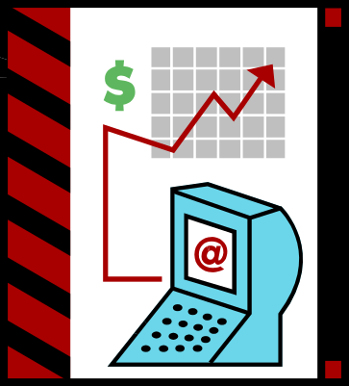

Week 3
Assessing the Market
AREC 213
Notes:
Market assessment is a process of ordering and structuring something you do every day.

Slide 2

Spotting Opportunities
Lifestyle and
Taste Changes
Government
Rules Changes
Demographic
Changes
Economic
Dislocations
Technological
Advances
Calamities
Market Assessment

Slide 3



Getting Started in Business
Buy an Existing
Business
Buy a
Franchise
Start from Scratch
Market Assessment

Slide 4

So What is a Market Assessment?
Structured approach to defining demand potential
Identify customers
    Who
    How Many
    Where are They
    How to Reach them
    What motivates them to buy?
How Big is the Market?
Is the Market Growing?
Market Assessment

Slide 5

Why Do It?
Spot Potential Sales
Understand the Opportunity
Reduce Business Risk
Plan Your Marketing Approach
Spot Potential Problems
Make Informed Decisions
Market Assessment
Better Decision Making

Slide 6

What are You Trying to Learn?
How big this market is
How fast this market is growing
Who and where the ideal customers are
These Answers Drive your Marketing and Sales Plan
Market Assessment

Slide 7

The Language of Markets
Industry
Segment
Target Market
Niche Market
Target Customer
Positioning
Market Assessment

Slide 8

Markets & Industries
Markets consist of Customers - Buyers
  People or Businesses
  Willingness to Buy
  Ability to Buy
  Unsatisfied or Unmet Needs
Industries consist of Sellers
  Companies producing goods or services
  Located somewhere in the Value Chain
  In search of customers
Market Assessment

Slide 9

Market Segment
The division of broad markets into smaller groups sharing similar needs and attributes
Most broad markets have several distinct segments
  Gourmet Chefs vs Cooks
  Vegans vs Vegetarians
Market Assessment

Slide 10

Customer Segments
Segmentation Axes
  Demographics
    Age
    Gender
  Economic
    Income
    Spending Habits
  Geographic
    Location
    Where they Buy
  Psychographic/Behavioral
    Why they Buy
    Lifestyle
Market Assessment

Slide 11

Your Target Market
The Segment(s) on which Your Business can Focus
The Segment(s) in which Your Business has an advantage
Your Niche Market
Market Assessment

Slide 12

Target Customer
Those customers who,
when presented with perfect information about your product or service,
along with your competitors’,
WILL BUY YOURS!
Market Assessment

Slide 13
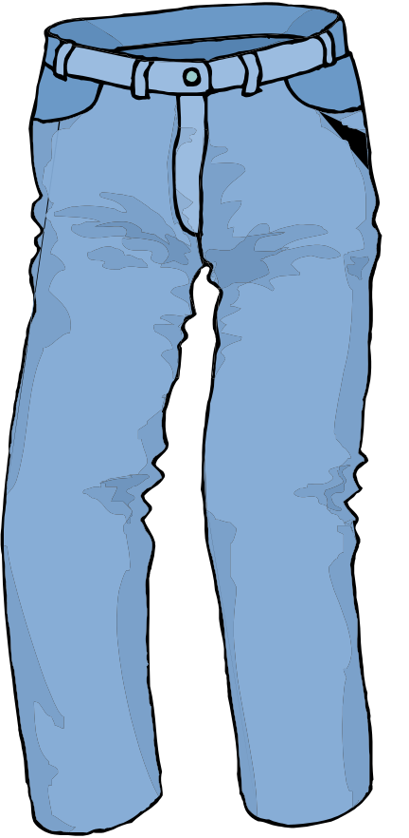
Positioning
How your target customers’ perceive your product vis a vis competing alternatives
Consciously molded by your market strategy
Independently internalized by your customers
Market Assessment

Slide 14
Market Research Result
Target Customers
Target Market
Focused Research
Broad Market
Market Assessment

Slide 15

Types of Market Research
Primary – Do Original Investigation
  Direct Observation
  Surveys & Questionnaires
  Interviews
Secondary – Use Existing Data
  Internet Searches
  Trade Publications
  Libraries
Market Assessment

Slide 16

How to do Primary Research
Work in the Industry
Interview Competitors
Act Like a Customer
Surveys & Questionnaires
Give out Samples
Interview
  Friends & Family
  Potential Customers
  Experts
Market Assessment

Slide 17

Secondary Market Research
Industry reports written by professional research firms and/or associations
Industry Overview & Snapshot
  Where is the Market Going?
  Overall Growing or Shrinking?
Limitations
  Not local market specific
  Not product specific
  Cannot query
Market Assessment

Slide 18








Industry Research
Identify Professional Trade Association Information Sources
Oregon Association
of Nurseries
NW Seed Orchard Association
Market Assessment

Slide 19
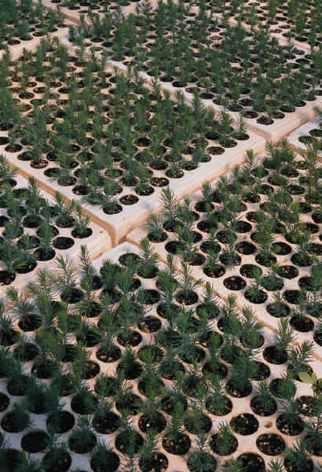
Secondary Market Research
Oregon Association of Nurseries
  After growing only 4% between 2004 and 2005, market grew 10% to $966M in 2006.
  2007 growth anticipated to be 8% slowing to 5% in 2008
  2006 growth due to increasing prices and increasing volume
  Steeper competition from imports
  Shrinking pool of workers
  Anticipating slow down in housing market
Market Assessment

Slide 20

More Secondary Market Research Resources
Get General Information about your Geography
http://factfinder.census.gov/home/saff/main.html?_lang=en
Market Assessment

Slide 21
Industry Research
Identify Industry using the NAICS (North American Industry Classification System)
Much data organized around NAICS code
  http://www.census.gov/epcd/www/naics.html
Market Assessment

Slide 22

Market Research Example
Soapy Rides Car Wash
Car Wash and Detailing Business
Three primary Target Customers
  Luxury Car Owners
  New & Used Car Dealerships
  Fleet Owners
Market Assessment
Example from: Thomson Business & Professional Publishing

Slide 23
Market Research Example
Soapy Rides Car Wash
Step 1 – Identify Industry – NAICS
811192 Car Washes - This U.S. industry comprises establishments primarily engaged in cleaning, washing, and/or waxing automotive vehicles, such as passenger cars, trucks, and vans, and trailers.
2007 NAICS | 2002 NAICS | 1997 NAICS | Index Entries for this Industry
811192 | 811192 | 811192 | Automotive detailing services (i.e., cleaning, polishing)
811192 | 811192 | 811192 | Automotive washing and polishing
811192 | 811192 | 811192 | Car detailers
811192 | 811192 | 811192 | Car washes
811192 | 811192 | 811192 | Detailing services (i.e., cleaning and polishing), automotive
811192 | 811192 | 811192 | Mobile car and truck washes
811192 | 811192 | 811192 | Self-service carwash
811192 | 811192 | 811192 | Truck and bus washes
Use this code to find Market & Industry Descriptions, Sizing, & Trends
Market Assessment

Slide 24

Market Research Example
Soapy Rides Car Wash
Local Information
Census Data
  Population 160,000
  Car Owners 100,000
New & Used Car Dealerships
  15 within 7 miles
Businesses with Fleets
  10 within 5 miles
Yields Descriptions of Target Markets
Market Assessment

Slide 25

Market Research Example
Soapy Rides Car Wash
Trade Associations
http://www.carwash.com/index.asp
Yields detailed trends in products, services, and technologies
Market Assessment

Slide 26
Market Research Example
Soapy Rides Car Wash
Target Customer Information
Segmentation Plan
  New car owners 7.2% 7200
  Older luxury cars 12.5% 12500
  Sports cars 17% 6500
  Lifetime owners 17% 17000
        43200
Further break down car owners by psychographics, demographics, economics to yield
TARGET CUSTOMERS!
Market Assessment

Slide 27

Market Research Example
Soapy Rides Car Wash
Target Customer Information
Break down Dealerships – which are customers or potential customers?
Yields Detailed Customer Descriptions
AND Drives Initial Sales Forecasts
Market Assessment

Slide 28
Market Research Results
Target Customers
Target Market
Focused Research
Broad Market
Broad Market
When you REALLY know your Target Customer, you can design your Marketing and Sales Plans to reach them.
Market Assessment

